Slide 1
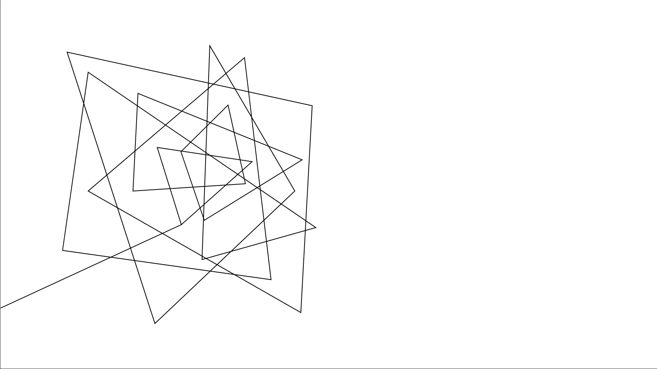
Dr. Pill
Automatic Pill Dispenser

Slide 2




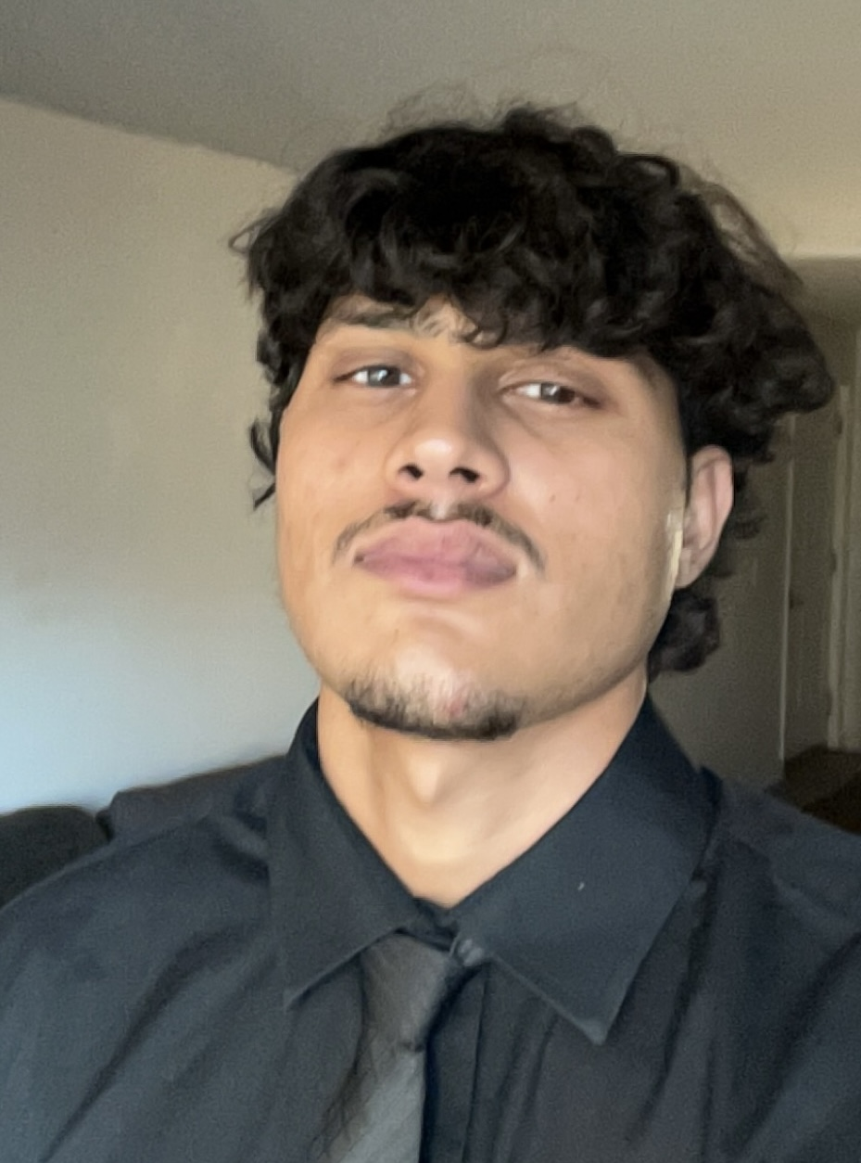
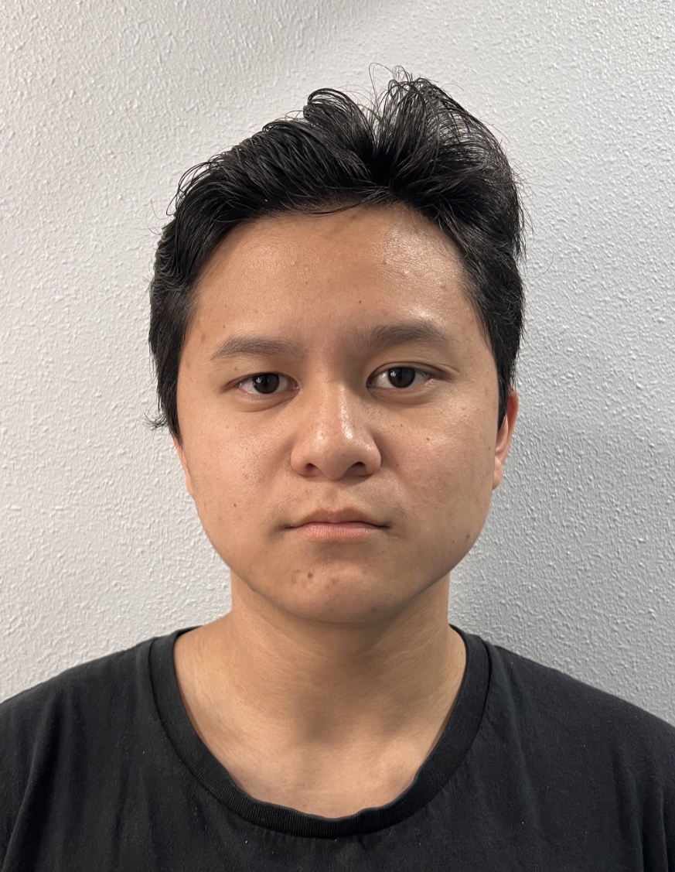
MEET THE TEAM
Jonathan Cerniaz
Jehmel
Espiritu
Jeremy Espiritu
Joseph Guzman
Afzal
Hakim
Lee Roger
Ordinario
Power Supply & Regulation
Circuit Design
Software Development of Interface
Software Development of Interface
System prototyping and calibration
3D Design
Log tracking and Security
Pill Storage System and Organization
Soldering

Slide 3
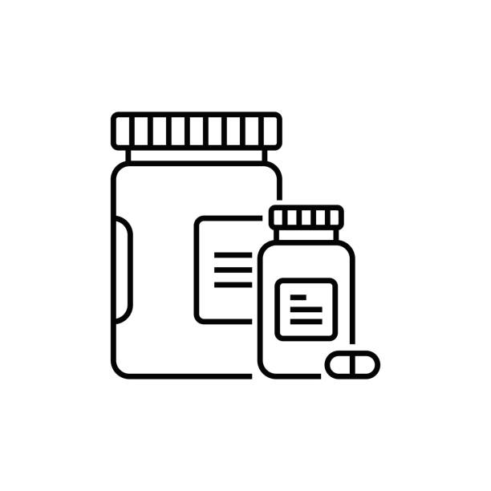
PROJECT OVERVIEW
Our project consists of 3 major parts:
Pill Dispensing
Touchscreen Display
Authenticators and Database
Dr. Pill

Slide 4
OUR 3 DEMOS
First Demo:
Dispense Mechanism & Storage​
Second Demo:
Displaying User Interface​
Third Demo:
Authentication Device & Log Tracking
Final Demo:
The complete device 'Dr. Pill'
The Automatic Pill Dispenser
Dr. Pill

Slide 5
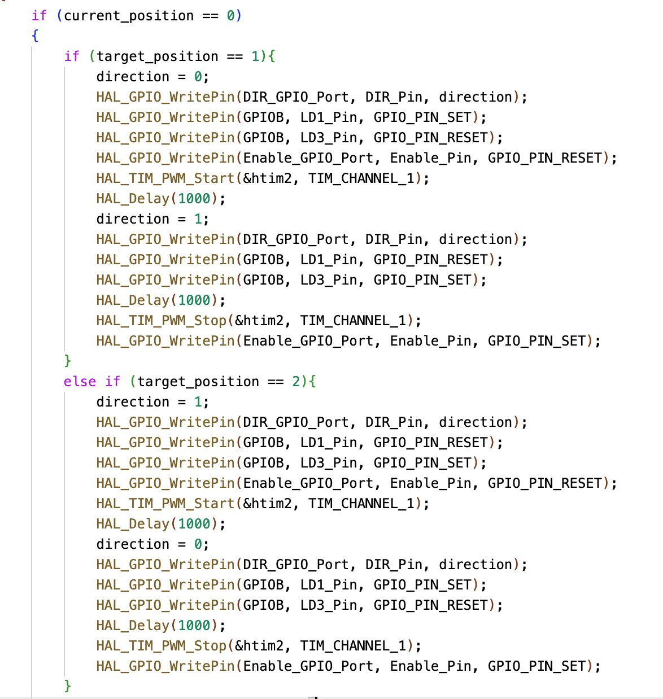
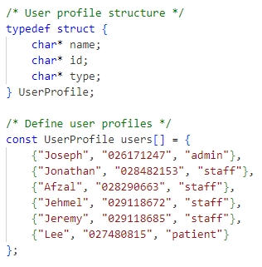
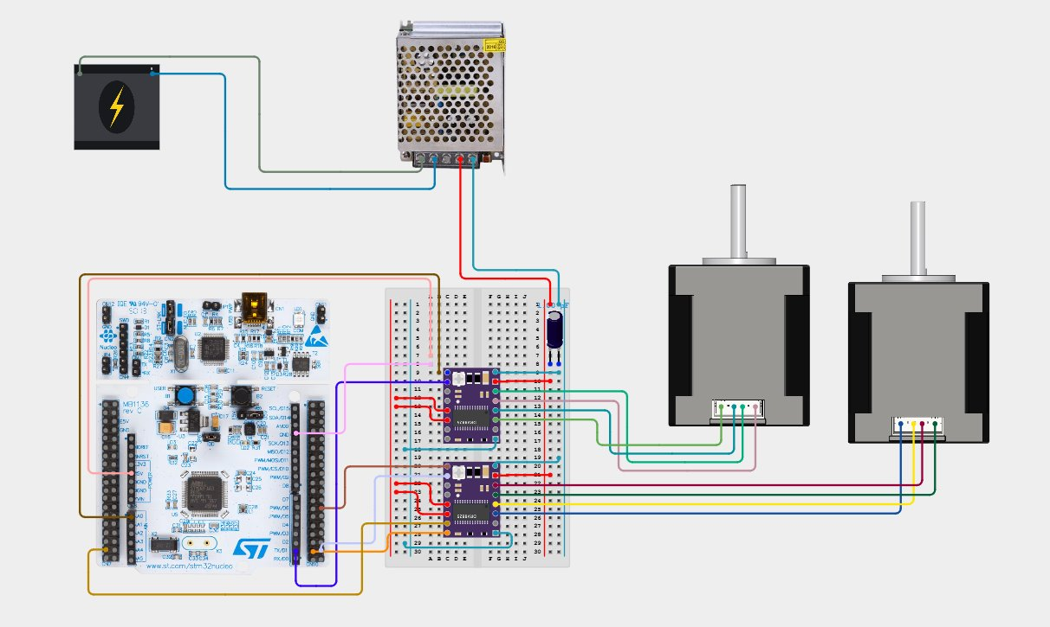
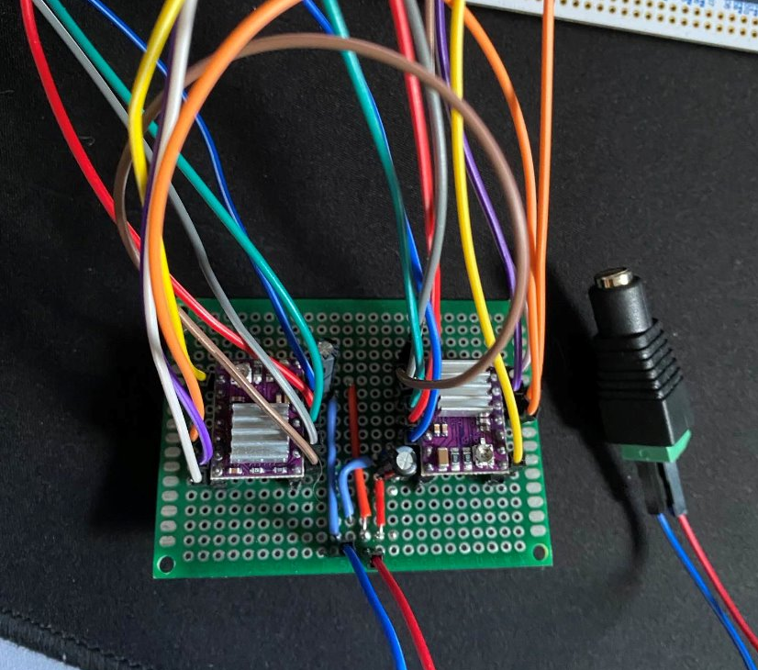
PREVIOUS demonstration
UART through MobaXTerm
NEMA 17 motor
Interface menus
Diagram of circuit
Dr. Pill

Slide 6
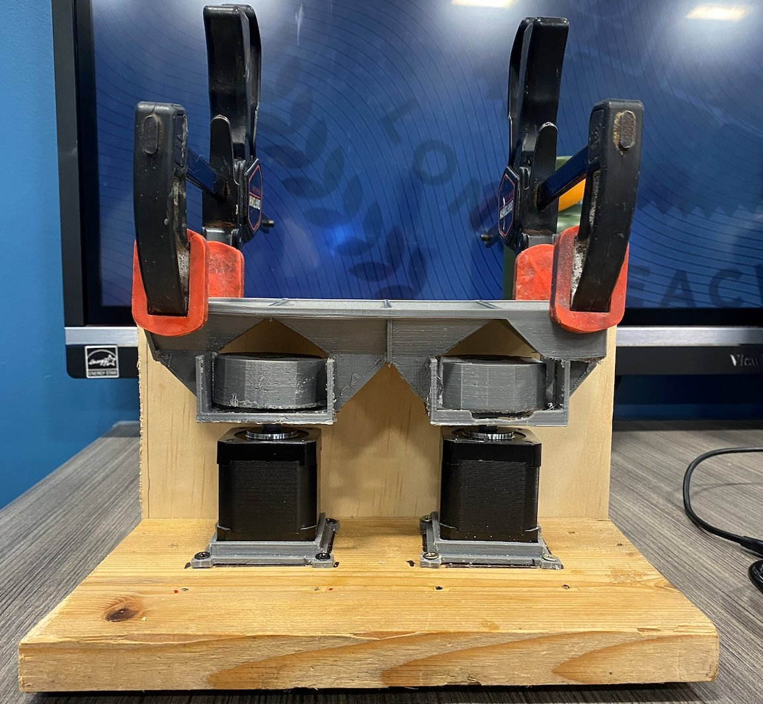
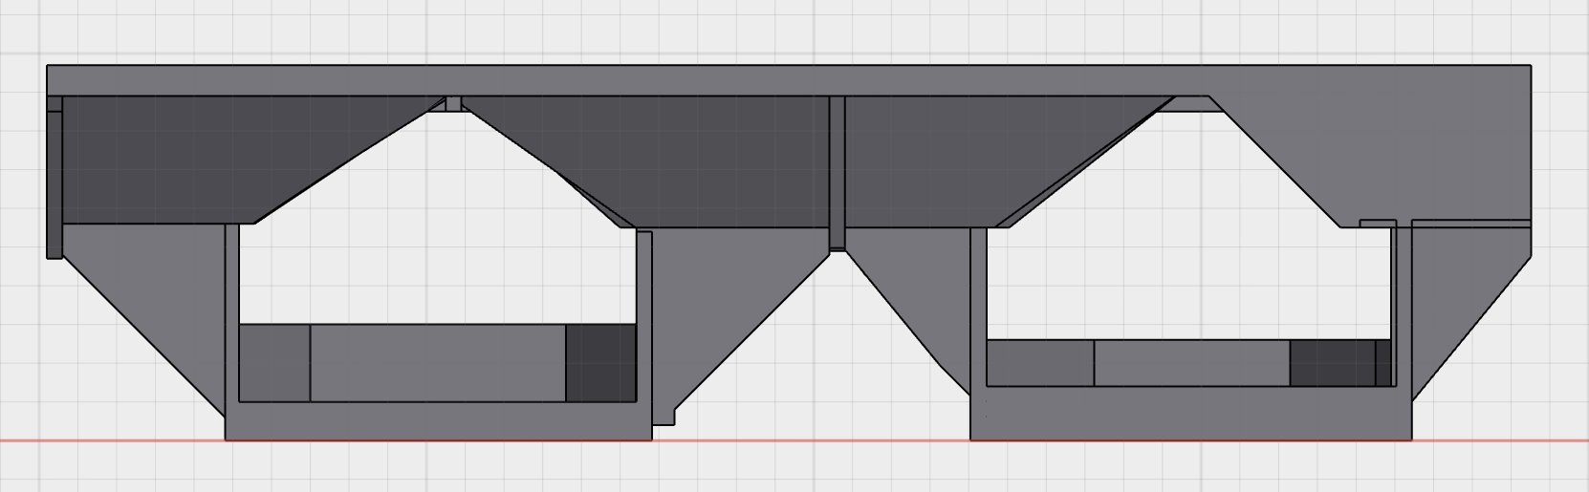
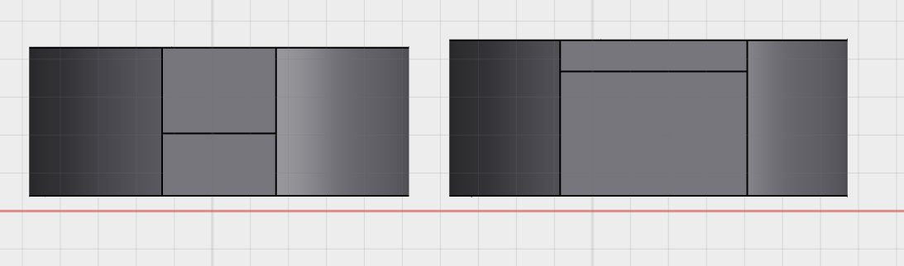
PREVIOUS demonstration
3D Design (Pocket & Storage)
Clamps were not reliable due to positioning not being perfect
Wear and tear on the motor stem
Ran into complications with pill dispensing due to jamming of the pills
Dr. Pill

Slide 7
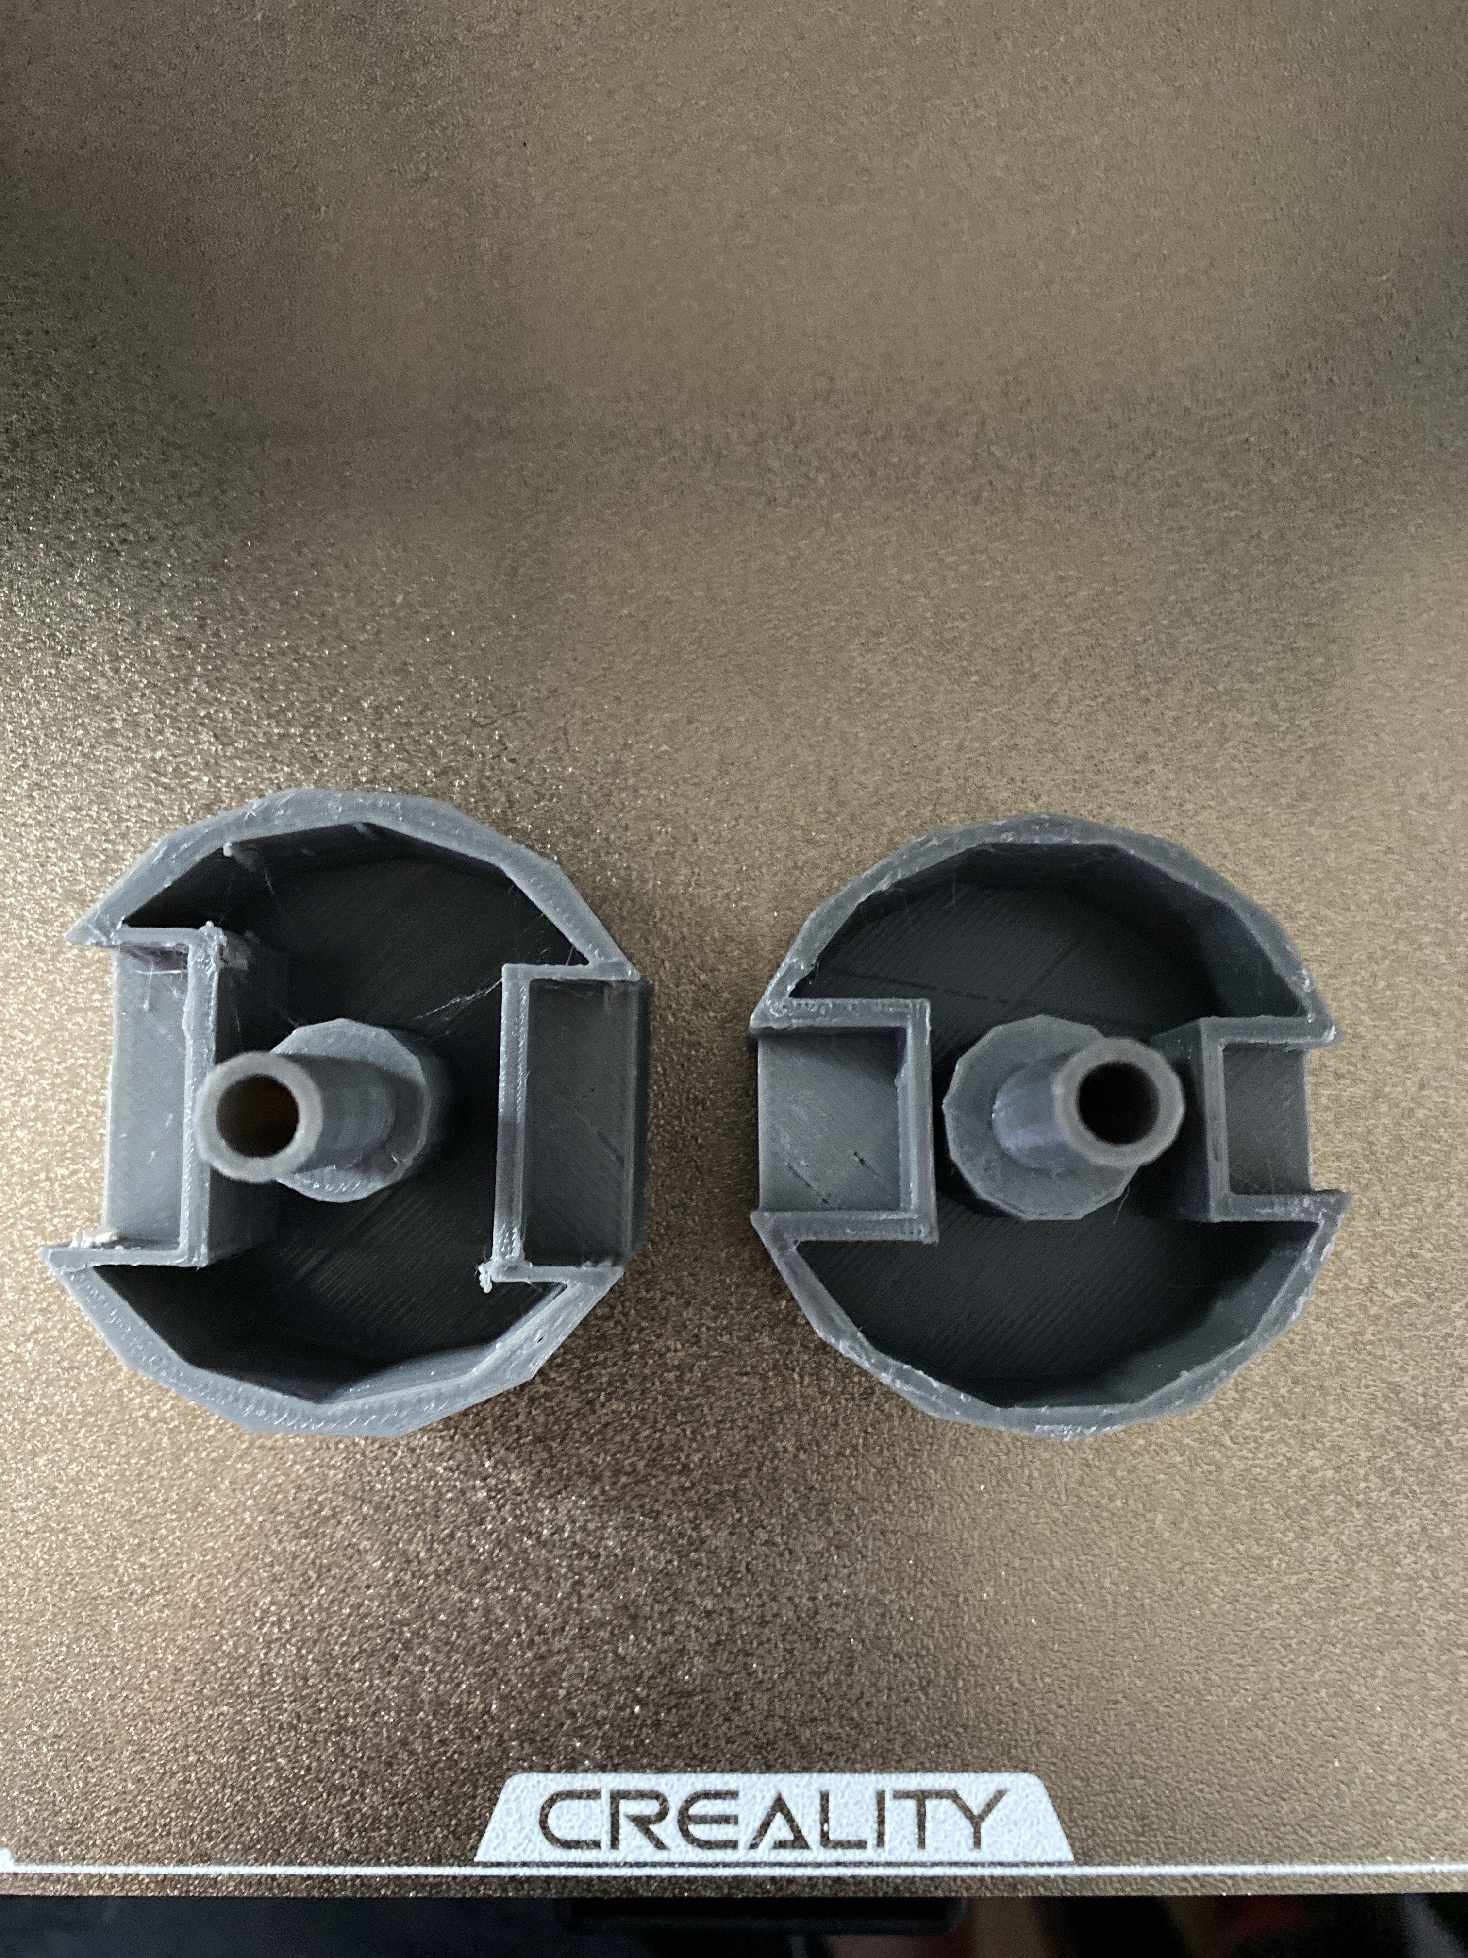
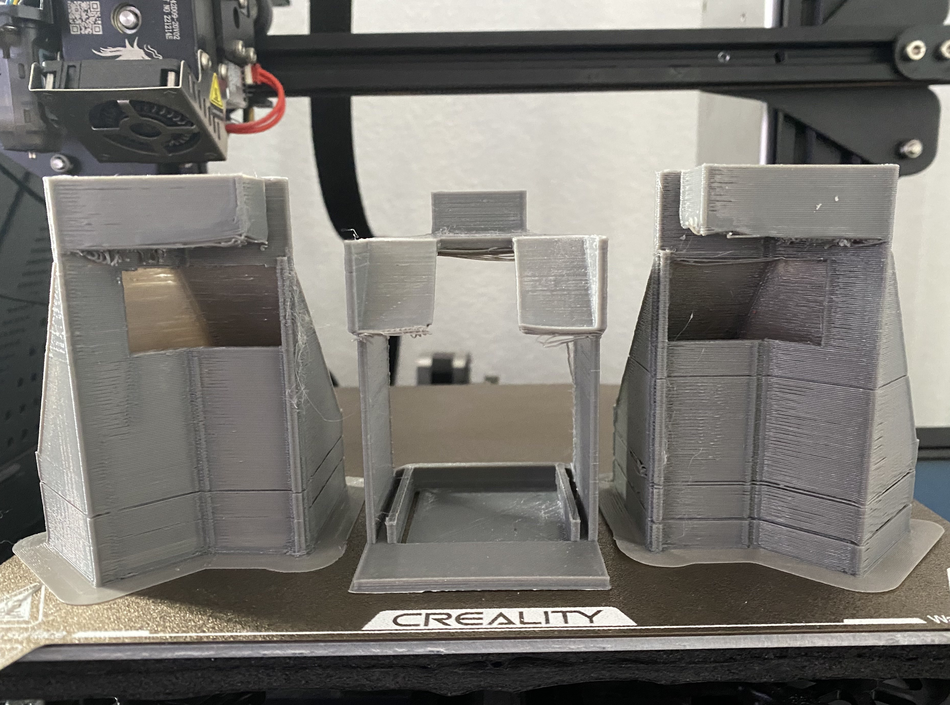
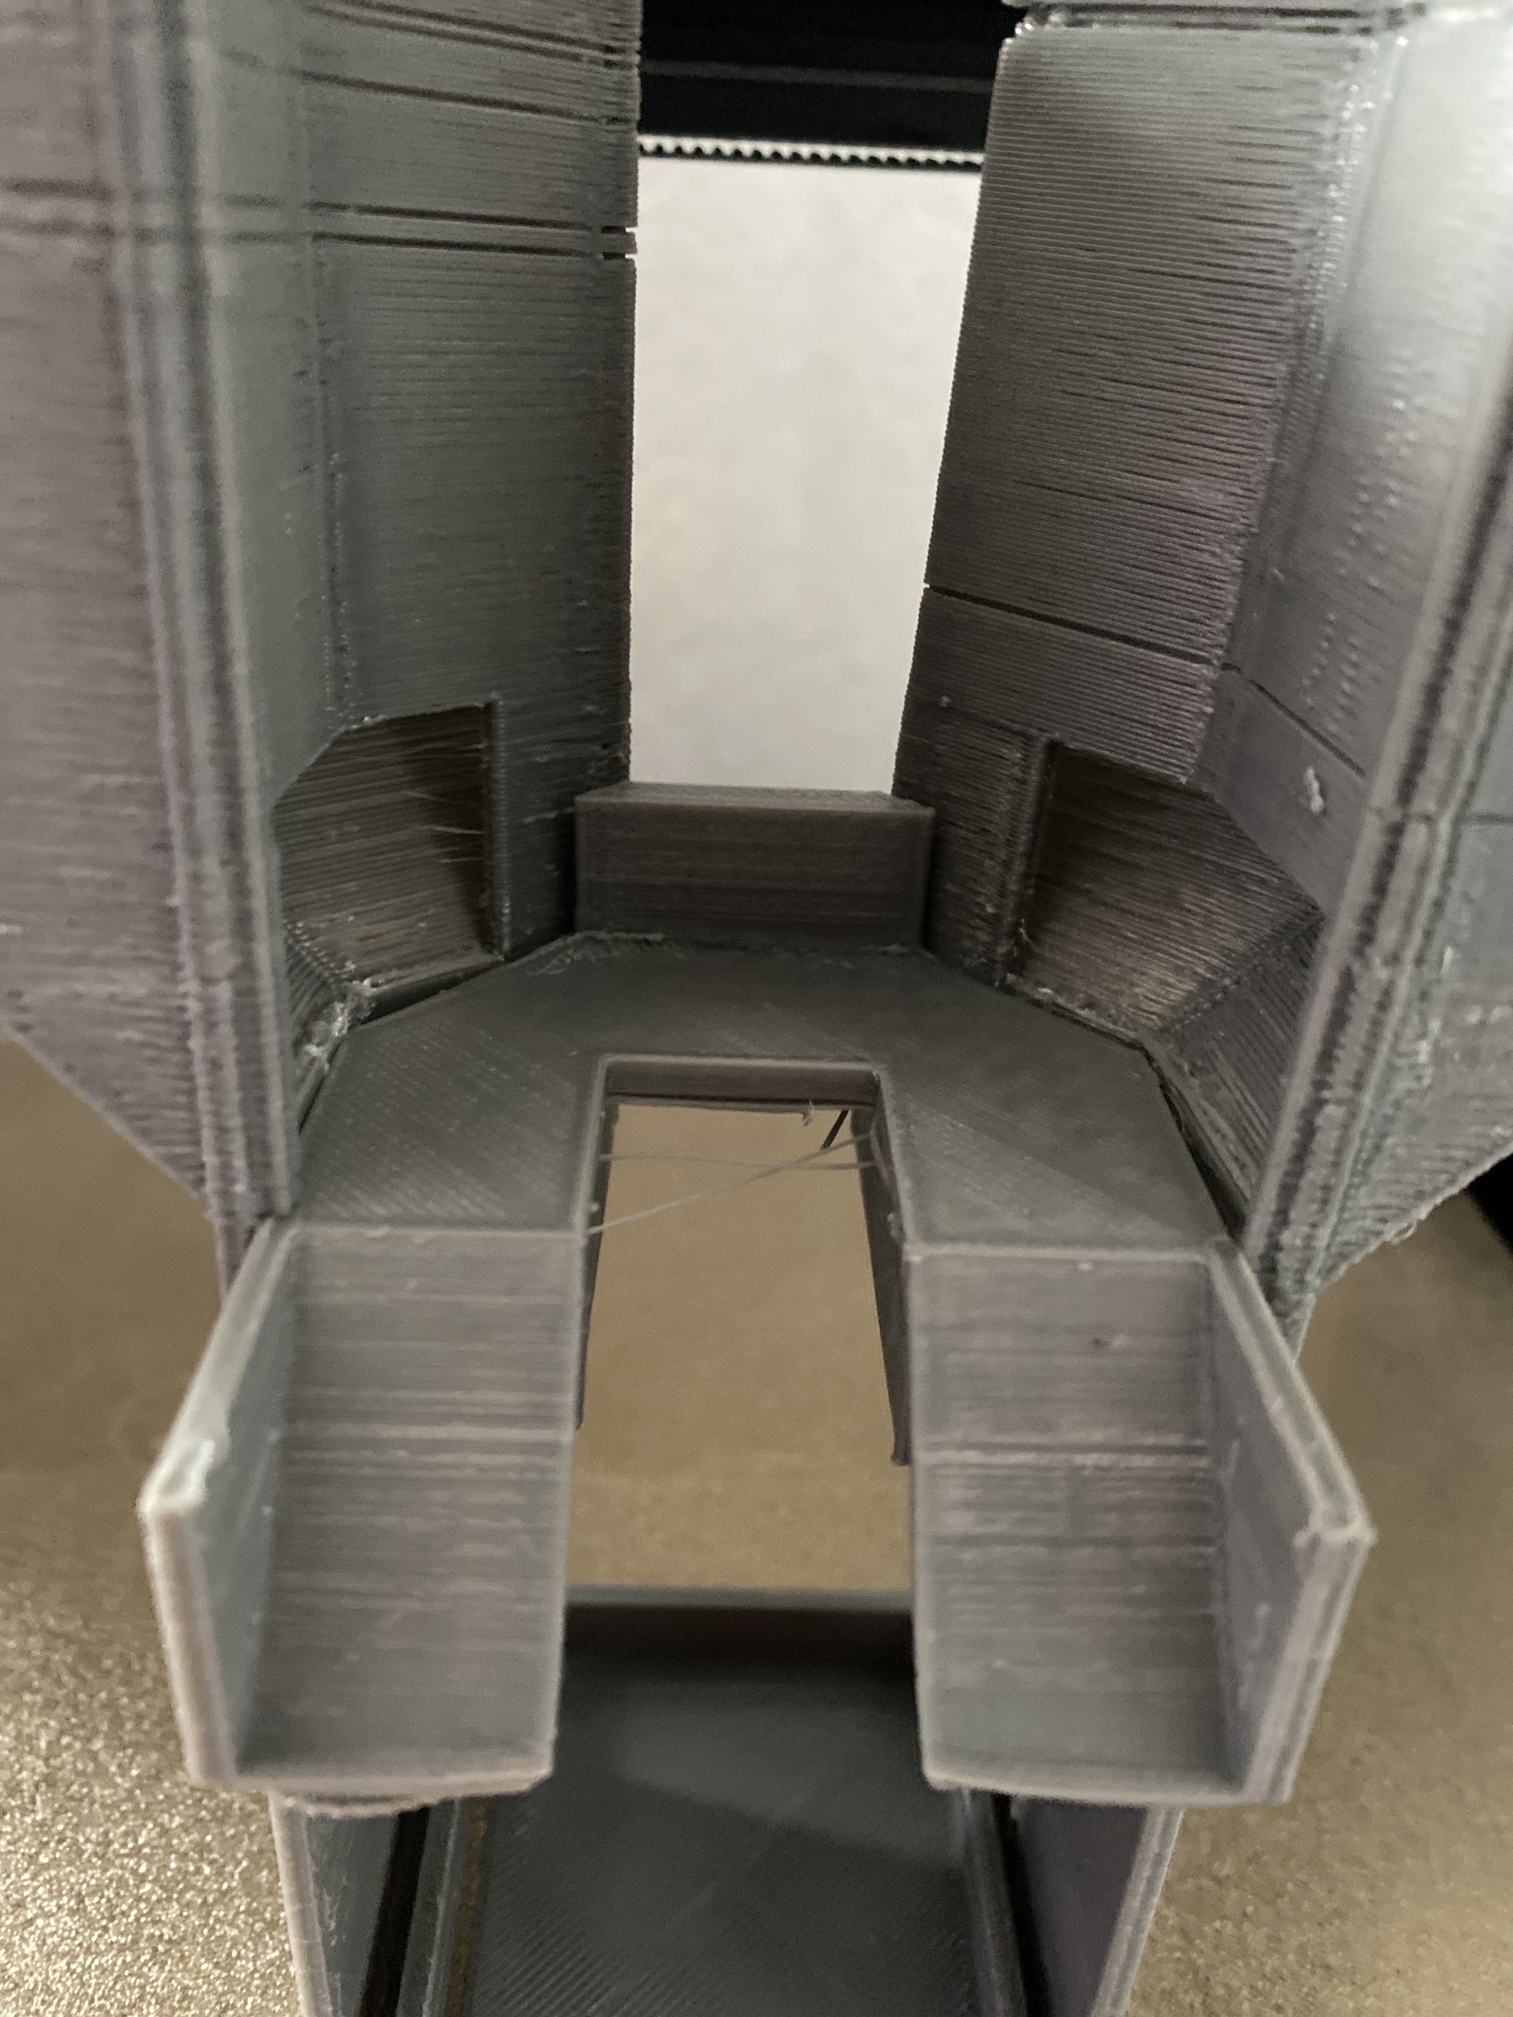
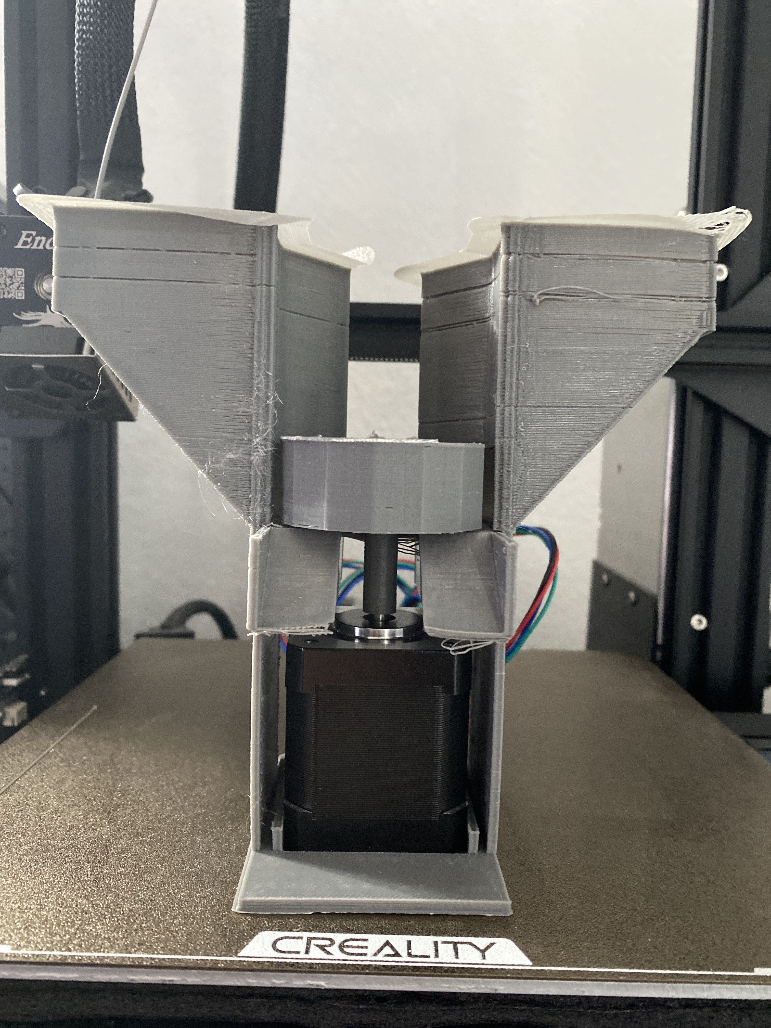
New DESIGN
Motor stem
Motor stand
Interchangeable storages
Increased pill capacity
Decreased chances of pill jamming
Dr. Pill

Slide 8
Today's demo
Displaying User Interface/Touchscreen
Requirements: Touchscreen works properly, Numpad works, STM32F767ZI is working with touchscreen inputs
Constraints: Power Consumption, Motor Response from Raspberry Pi
Success: Motor is responding properly from touchscreen inputs
Dr. Pill

Slide 9
DEMO TIME

Slide 10
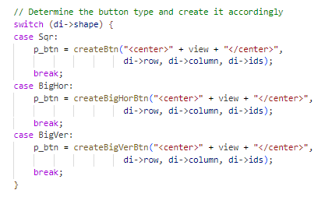
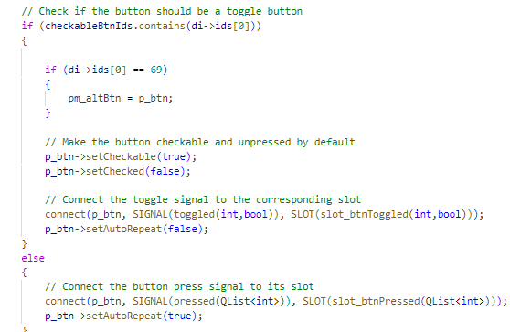
Technical details
Dr. Pill

Slide 11
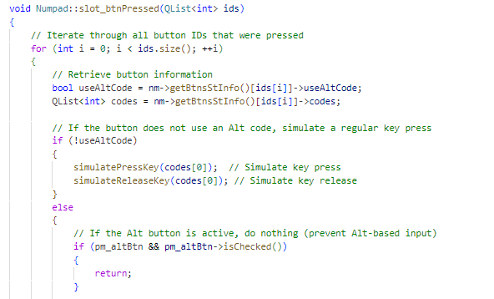
Technical details
Dr. Pill

Slide 12
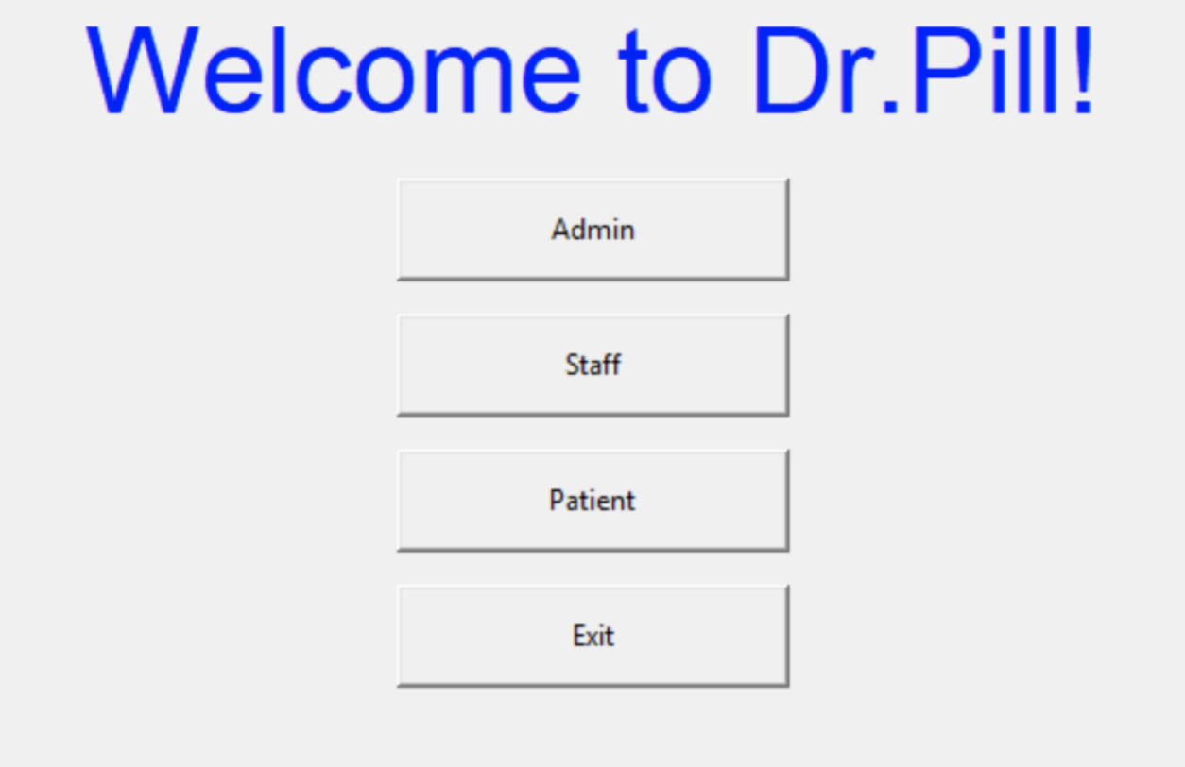
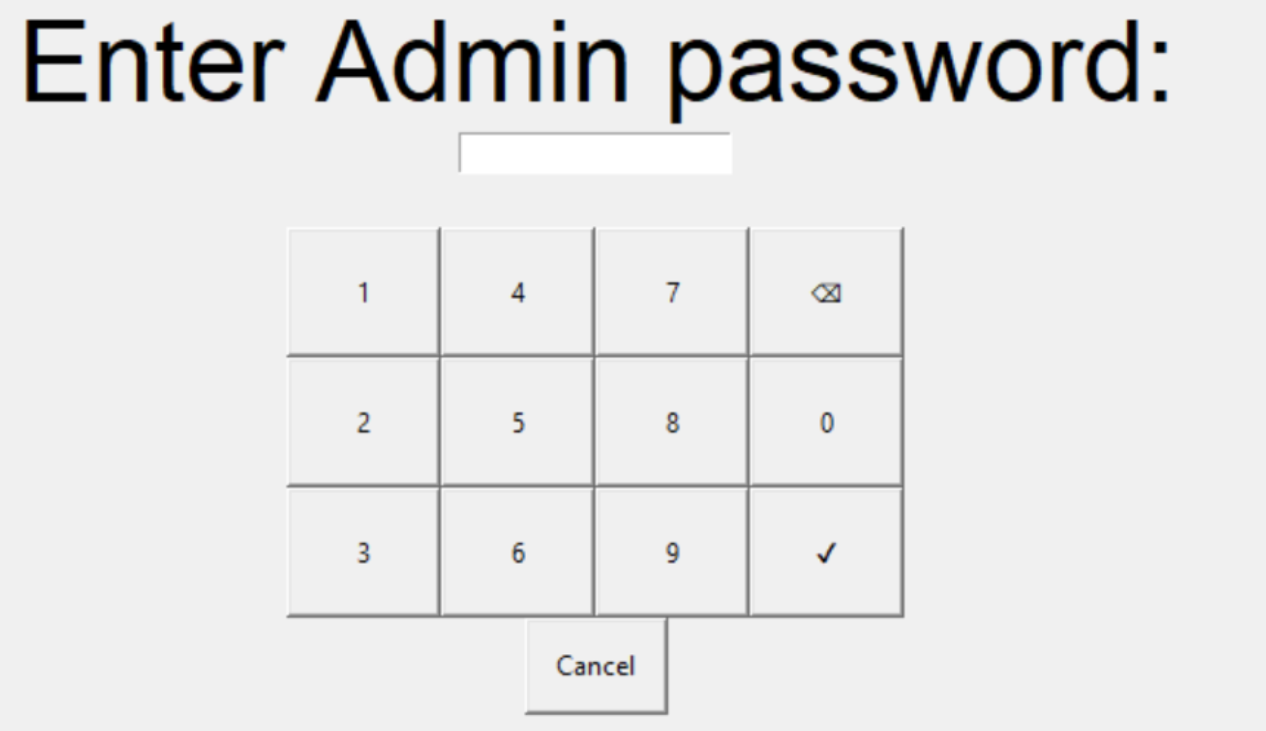
Technical details
Dr. Pill

Slide 13
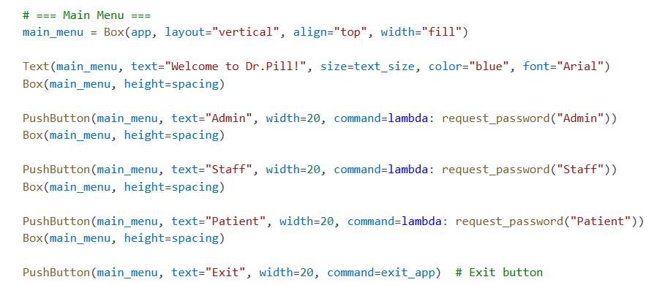
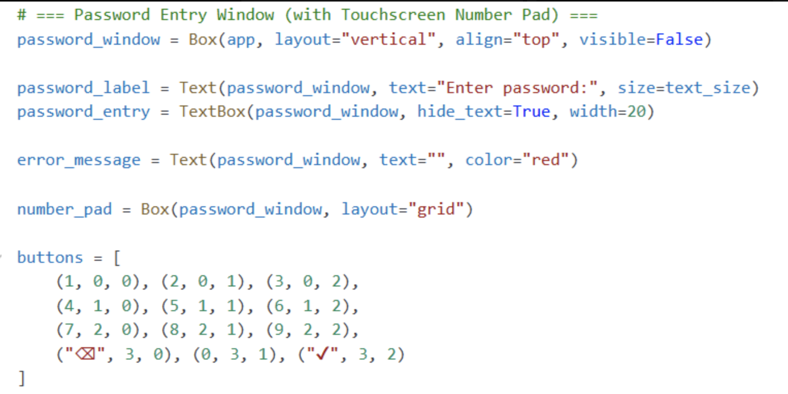
Technical details
Dr. Pill

Slide 14
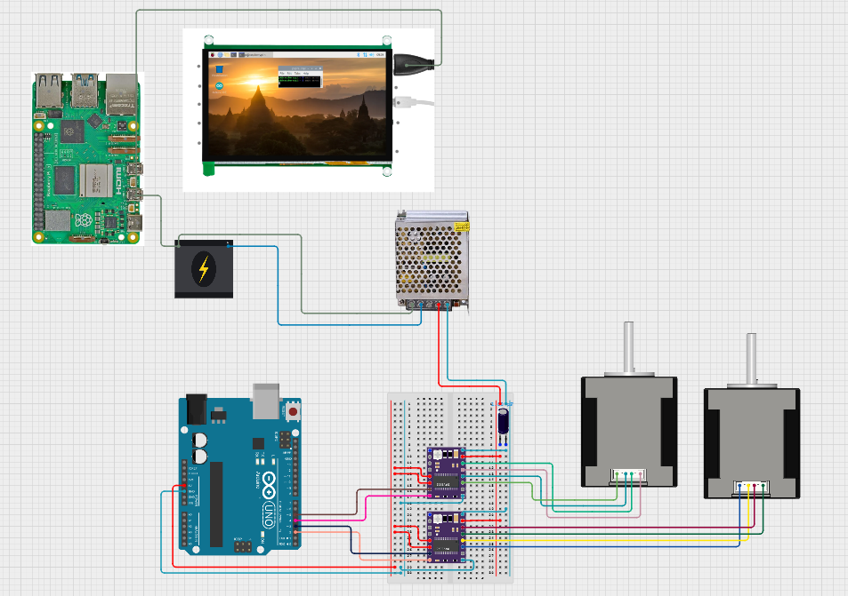
Technical details
Dr. Pill

Slide 15
challenges
Raspberry Pi overheating
Touchscreen not properly responding
Motor not responding from touchscreen inputs
Issues with IDE on different devices
OS issues
Dr. Pill

Slide 16
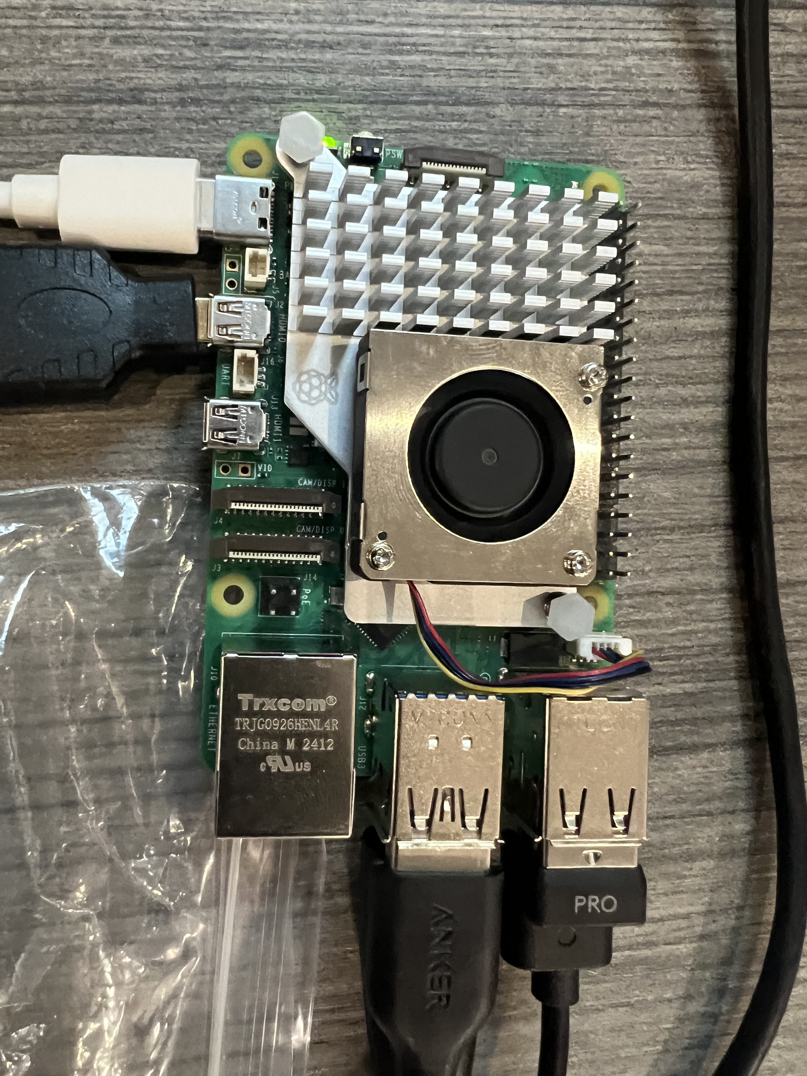
Overcoming challenges
Raspberry Pi overheating
Ended up buying cooler for the pi to reduce the temperature to prevent it from slowing down all our systems
Touchscreen not properly responding
Used various kinds of touchscreen drivers to see which one was responding the best
Motor not responding from touchscreen inputs
Tried various ports on Raspberry Pi that gave the best response
Dr. Pill

Slide 17
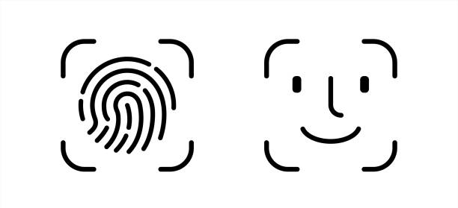
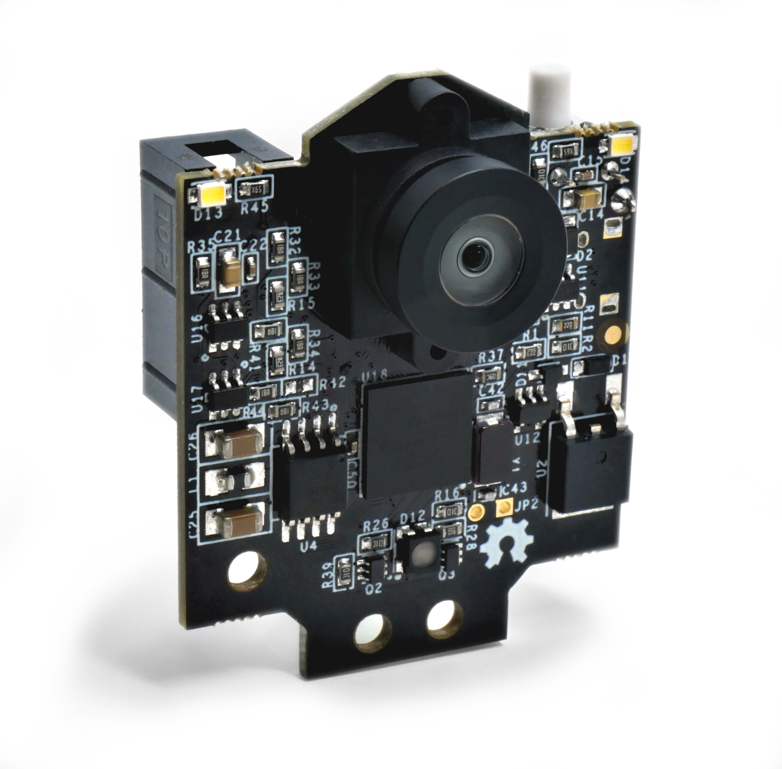
NeXT demo
Authentication: Users log in via fingerprint or facial recognition and their details are logged instantly.
User Management: Create and manage user profiles directly from the server and sync it with the device.
Logging Data: Every login event is recorded for tracking and security.
Object Recognition: Ensuring the correct pill is dispensed through sensor verification.
Dr. Pill

Slide 18

Thank You
Dr. Pill

